Slide 1
The Primitives:
Chassis and Strains
Notes:
All genetic engineering experiments today begin with some pre-existing biological sample that is already competent for translation and transcription. Usually that sample is a cell like E. coli, yeast, or mammalian cells. Alternatively, that sample could be a reconstituted in vitro system made from transcription and translation proteins and RNAs that were isolated from some cell. Regardless, there are core central dogma processes that must be present to have a biological system. When we speak of a chassis, we are referring to this sample that provides the central dogma processes.

Slide 2
Popular Chasses
E. coli
S. cerevisiae (‘yeast’)
H. sapiens
S. elongatus (‘cyanobacteria’)
Various plants
In vitro
E. coli
The Chassis provides:
Encodes the central dogma processes
Represents the initial state of biochemical system
Stable replication of DNAs
You are designing a ‘strain’ by starting with a ‘chassis’
Notes:
The most common chassis for synthetic biology in its early years was E. coli, but S. cerevisiae is king as of 2014, and other organisms including human cells, cyanobacteria, a few plants are increasingly getting attention. Additionally, in vitro systems are becoming very popular due to their utility in rapid prototyping by avoiding the need for time-costly transformation steps.
*
The chassis provides transcription and translation, and it also sets the initial state of biochemical system including all its metabolites. For the cell-based chassis, they also provide stable replication of the DNAs.
Beyond this basic definition of what the chassis provides, a general idea of synthetic biology that distinguishes it from more traditional genetic engineering approaches is to consolidate the list of organisms that go into the experiment. For example, I say yeast is ‘king’ today because instead of identifying obscure organisms that already have a desired property and trying to grow them at scale, most synthetic biologists like to start with S. cerevisiae because of the enormous infrastructure and experience that is already in place for handling this particular species. Thus, when synthetic biology people speak of the chassis, they not only speak of the the chassis as the initial organism being modified, but they also speak of a specific short list of species and thus ‘the yeast chassis’ or the ‘e. coli chassis’.
*
The term ‘strain’ refers to a specific genetic composition and lineage. When you put a custom-designed plasmid DNA into a common lab strain of E. coli, the E. coli strain was the chassis, but what you have constructed is a unique and specific strain.

Slide 3
E. coli as a chassis
What is E. coli?
Notes:
E. coli remains a very common chassis for synthetic biology experiments and in industrial production. It is also a workhorse for basic genetic manipulations even when the target organism is something different. Thus it is important to know some things about this species.

Slide 4
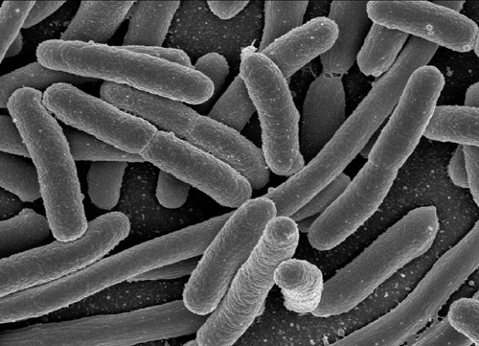
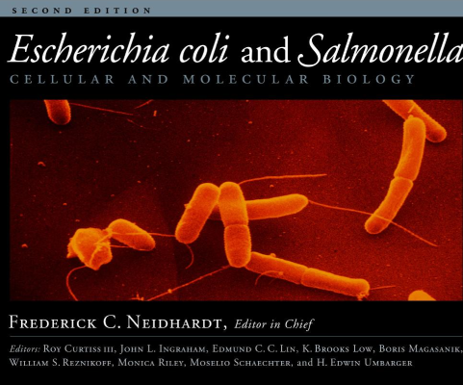
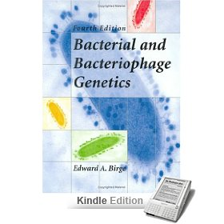
The E. coli chassis
MG1655/W3110 lineage (and B and W)
Escherichia coli and Salmonella: Cellular and Molecular Biology
By Frederick C. Neidhardt, Roy Curtiss, American Society for Microbiology
Bacterial and Bacteriophage Genetics (Hardcover)
By Edward A. Birge
Notes:
The most common laboratory strains in use today are derivatives of an ancestral E. coli isolate named MG1655. The name W3110 refers to an almost identical organism. This strain of E. coli is often referred to as ‘K12’ which is its serotype, which we’ll come back to later. There are various E. coli strains that are not in this lineage and in common use. For example, BL21 is used extensively in industry and in the wetlab for protein overexpression. It is an E. coli B serotype strain, is of a distinct lineage from K12, and has significant genetic and biochemical differences. E. coli W strains are also found in industry and some of the commercially-available competent cell products. However, the extreme majority of E. coli strains in common use are MG1655 derivatives. The book “Escherichia coli and Salmonella: Cellular and Molecular Biology” is a large two-volume run down of all the biology of these two species. Another great book describing all the gory details of enterobacterial biology is Bacterial and Bacteriophage Genetics.

Slide 5
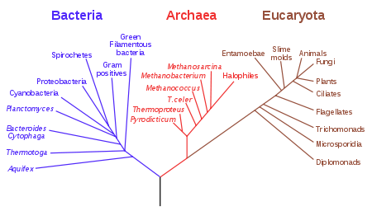
Taxonomy
γ-proteobacteria
Notes:
In the big tree of life, E. coli lives within the bacterial kingdom amongst the gamma-proteobacteria.

Slide 6
Genuses
γ-proteobacteria > Enterobacteriales > Enterobacteriaceae
Citrobacter
Escherichia
Klebsiella
Proteus
Salmonella > Salmonella typhi (typhoid fever), Salmonella typhimurium
Serratia
Shigella
Yersinia > Yersinia pestis (bubonic plague)
Notes:
Inside the gamma-proteobacteria, E. coli is part of the enterobacteria family which is composed of various other genuses including salmonella and shigella. Since these organisms reproduce asexually, speaking of species and genuses is a fuzzy concept, and in practice specific strains within these species are often as similar to those in other species as they are to one another. For example, some strains of Shigella and Escherichia differ only by a few specific genes. The enterbacteria include primarily organisms that reside in the guts of animals, hence the name, and as such some of them are commensal and some of them are pathogenic. You have likely encountered the Salmonella genus in the context of contaminated chicken and eggs. One specific clade of strains, Salmonella typhi refers to multiple specific strains that are genetically similar-but-not-identical. They are defined by their ability to cause typhoid fever. Salmonella typhimurium strain LT2 is a somewhat common lab strain which can cause diarrhea in humans and can kill mice. In terms of severity and risk, it is a wildly-different scenario to work with typhimurium versus typhi. Additionally in this clade are some well-known pathogens such as Yersinia pestis. Despite the presence of some notorious pathogens, most enterobacterial strains just hang out in the guts of animals and are part of the ubiquitous and healthy flora that exist in most animals.

Slide 7
E. coli Strains
Dominant “facultative anaerobe” of the human large intestine
Particular strains of E. coli can infect most areas of the human body including brain (BMEC)
Most lab strains are derived from MG1655
Commensal > MG1655 lineage > DH10B, MC1061
also E. coli W, E. coli B > BL21
Enterohemorrhagic E. coli (EHEC) > 0157:H7 serotype > CDC B6914-MS1
Enterotoxigenic E. coli (ETEC)
Enteropathogenic E. coli (EPEC) > CFT073
Enteroinvasive E. coli (EIEC)
Enteroaggregative E. coli (EAggEC)
Notes:
Thus, pathogenicity is not a general property of any particular species except where the species is defined by its ability to cause an illness. Most of the prokaryotic species, including E. coli, are defined by ribosomal RNA sequence, general similarity of the entire genome sequence, and some specific assayable qualities. One of these distinctive properties of E. coli that define the class is the presence of lactose catabolic genes.
*
bullets
*
E. Coli strains are most often further characterized by types of virulence present in specific strains. Note that many of the strains are commensal including the MG1655 lineage, E. coli W, and E. coli B strains. Commensal means they persistantly reside in hosts, but they do not cause any observable harm. When scientists study bacteria, they principally study those that are detrimental to human health and thus most of the strains that have been characterized exhibit some form of harm. These different strains are further categorized by distinguishable clinical properties such as the location of the typical infection, the presence of toxins, or cross-reactivity of antibodies and thus immunity. One you may be familiar with is the enterhemorrhagic strain O157:H7. O157 refers to carbohydrates on the surfaces of many of these bacteria and H7 refers to a specific cluster of genes that encode a flagellum on the surface of the bacterium. Thus, these describe specific biochemical entities decorating the cell surface and are the primary sites of antibody recognition during infection. Since two strains can share O157 and H7 and still be very different at all other genetic loci, O157:H7 is a pattern of commonly co-associated genetic sequences, but does not refer to any specific strain. The O157:H7 strain CDC B6914-MS1 refers to a specific strain that contains the O157:H7 serotype and has a specific genetic composition.

Slide 8
Lab strains of E. coli
How do you read a genotype?
What’s special about the lab strains?
Notes:
Most strains of E. coli are from the MG1655 lineage, and can be thought of as minor mutants of that ancestral strain. When people speak of the E. coli chassis, they are generally referring to this and other lineages that are indistinguishable from each other in terms of the central dogma processes.

Slide 9
Understanding genotypes
DH10B
F⁻ endA1 recA1 galE15 galK16 nupG rpsL ΔlacX74 Φ80lacZΔM15 araD139 Δ(ara,leu)7697 mcrA Δ(mrr-hsdRMS-mcrBC) λ⁻
http://openwetware.org/wiki/E._coli_genotypes and
http://cgsc.biology.yale.edu/ for even more
Notes:
Any particular strain is often referred to by a genotype. It is a shorthand way of describing genome modifications present in that strain relative to MG1655. A long list of genotypes is available on openwetware, and yet more are detailed at the CGSC.

Slide 10
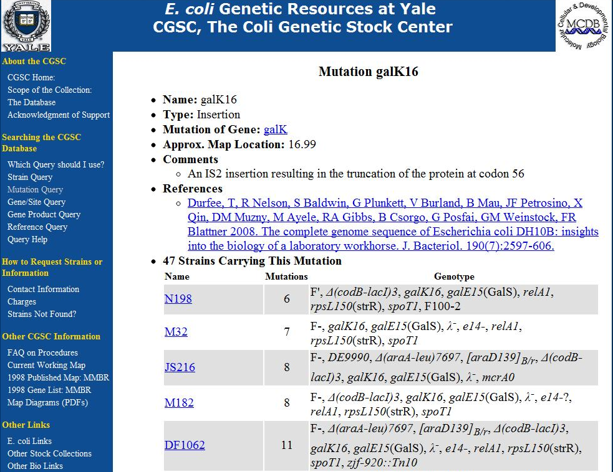
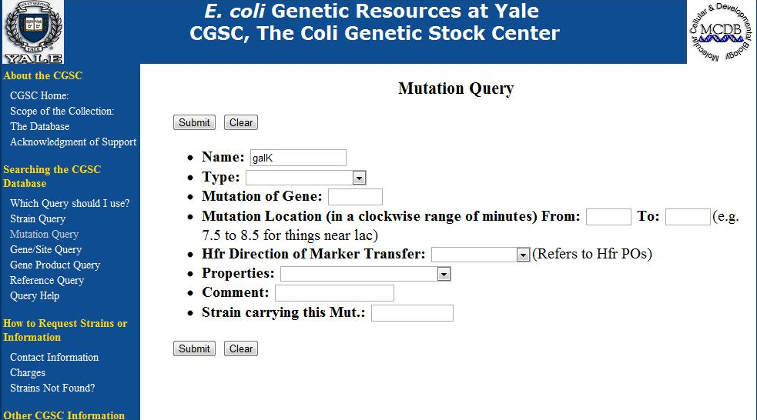
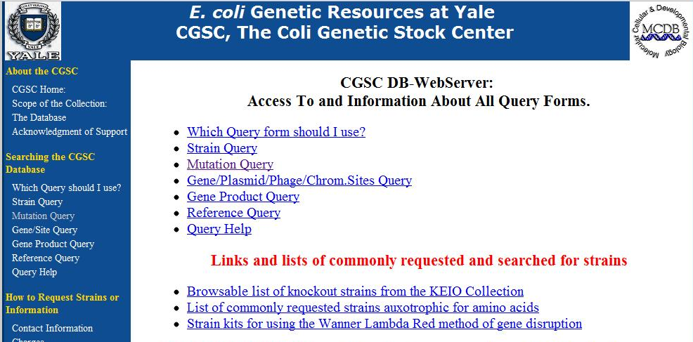
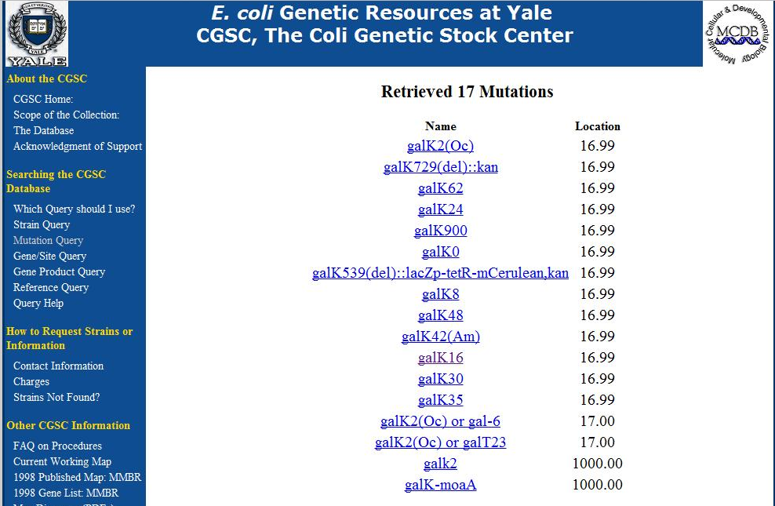
Using the CGSC
http://cgsc.biology.yale.edu/
Notes:
If you want some detail, I recommend visiting the CGSC where they will describe all these catalogued mutations in great detail. You go to mutation query, * type in the gene, * and it takes you to a page describing the various mutations that have been seen for that gene in some strain. You can then * click on one of these mutations to see a description of what it is in more detail. For example, the galK16 genotype term refers to the presence of an insertion element at a specific location of the galK gene. An insertion element is a mobile genetic sequence much like a transposon. Many other mutations are point mutations, large deletions, or insertions of phages and other mobile elements.

Slide 11
E. coli Lab Strains
DH10B
F⁻ endA1 recA1 galE15 galK16 nupG rpsL ΔlacX74 Φ80lacZΔM15 araD139 Δ(ara,leu)7697 mcrA Δ(mrr-hsdRMS-mcrBC) λ⁻
Removed endonucleases and recombination genes
http://openwetware.org/wiki/E._coli_genotypes
Notes:
There are certain mutations you’ll see in most popular strains. For example, there is a set of genes that make MG1655 more amenable to efficient DNA uptake. These include the endonuclease endA, the recombination gene recA, and the mcr, mrr and hsd genes involved in methylation and restriction.

Slide 12
E. coli Lab Strains
DH10B
F⁻ endA1 recA1 galE15 galK16 nupG rpsL ΔlacX74 Φ80lacZΔM15 araD139 Δ(ara,leu)7697 mcrA Δ(mrr-hsdRMS-mcrBC) λ⁻
Deletion of metabolic pathways, unable to grow on minimal media
http://openwetware.org/wiki/E._coli_genotypes
Notes:
Others refer to mutations causing a metabolic defect. Usually the name is descriptive of the phenotype that results. For example, galE15 and galK16 refer to mutations in galE and galK which make E. coli unable to use galactose as a carbon source. The araD mutation is a defect in arabinose utilization. A common marker is the delta-ara-leu mutation which is a large deletion that takes out the region of the MG1655 genome starting in a cluster of arabinose catabolic genes and extending many kb to the leucine biosynthesis genes. Thus, arabinose catabolism, leucine biosynthesis, and several other processes are absent in this strain.

Slide 13
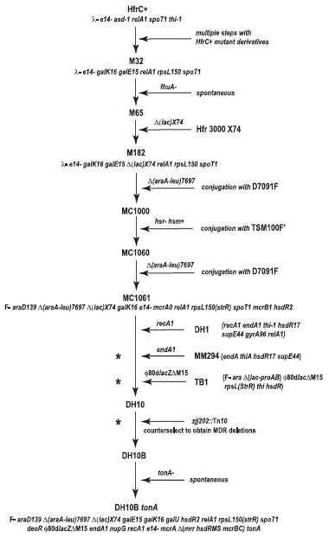
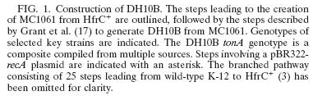
PMID: 18245285
E. coli genotypes represent the best-known composition of a strain as inferred from the manipulations used to generate them and the resulting phenotypes relative to the original MG1655 isolate. Very few have been verified by sequencing.
Notes:
E. coli genotypes represent the best-known composition of a strain as inferred from the manipulations used to generate them and the resulting phenotypes relative to the original MG1655 isolate. Very few have been verified by sequencing, but a few have. For example, DH10B’s lineage is shown, and also its genome is available.

Slide 14
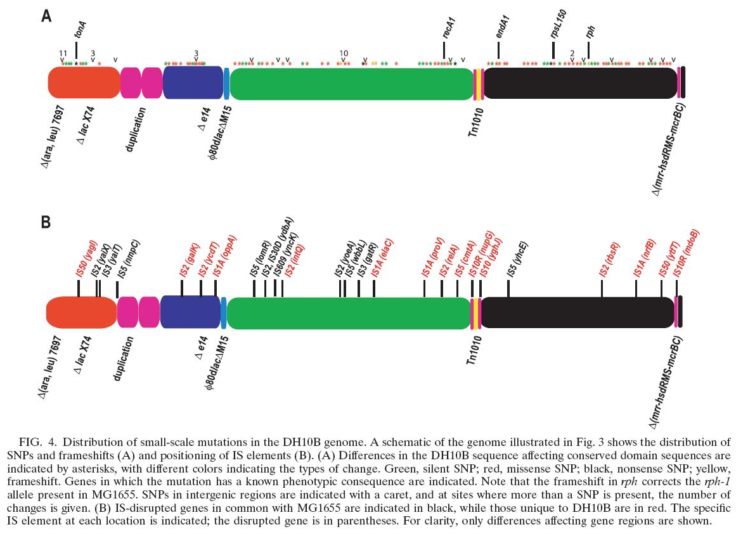
PMID: 18245285
Notes:
When you compare the genome sequence to the genotype, you find many mutations that aren’t accounted for. Presumably, most of these mutations have no phenotypic consequence and potentially can be ignored from further consideration. However, it is not uncommon to find that a particular strain has unlisted mutations that affect specific processes.

Slide 15
Primary and Secondary Processes
What do all bacteria have in common, and how do they vary?
What are minimal genomes?
Notes:
Prokaryotes are extremely diverse in some ways, and extremely self-similar in other ways.

Slide 16
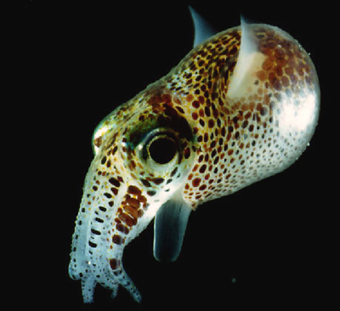
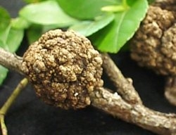
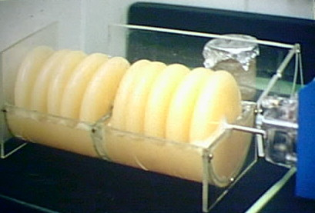
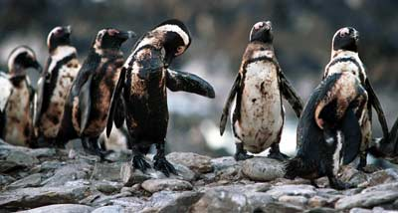
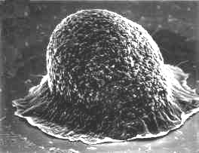
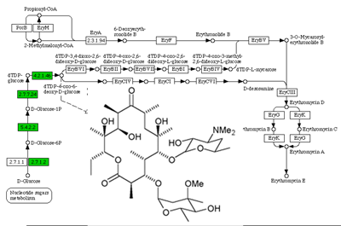
Celebrities of the prokaryotic world
Euprymna scolopes and symbiotic Vibrio fischeri
Agrobacterium infection
Fruiting Body formation by Myxococcus xanthus
Microbial cellulose production by Acetobacter xylinum
Erythromycin biosynthesis by Saccharopolyspora erythraea
Oil bioremediation by Acinetobacter sp.
Notes:
For example, there are many phenotypes that are only observed in one specific strain. For example, Vibrio fisherii forms light-generating organs within a specific species of squid. Other bacteria interact with plants, such as agrobacterium. Some live in soil and will have elaborate developmental processes. For example, myxococcus xanthus forms fruiting bodies that emit spores. Many of these exotic phenotypes are exploited in biotech applications. Some Acetobacter strains secrete a form of cellulose that is used to make microphone membranes. Many of the natural product small molecules used as drugs, including erythromycin, come from specific strains of bacteria. Also, bioremediation of chemical spills including oil happens due to the action of specific strains of abcteria.

Slide 17
A Core Bacterial Chassis
Cell growth and division
The Central Dogma
Primary Metabolism
Environment Sensing
~3000 genes common to all bacteria
Encoded by ~3 million bases of DNA
Almost identical among Enterobacteria
Notes:
Yet most of the genes in any given prokaryote are the same as all the others. There are a core set of processes associated with cell growht and division, the central dogma, primary metabolism, and environmental sensing that are ubiquitous to all prokaryotes and largely invariant in their details. Total, this requires about 3000 genes to encode and thus about 3 million basees of DNA. The set of genes involved in these processes is base-per-base identical amongst many enterobacterial genuses, and clearly homologous to those genes in other prokaryotes.

Slide 18
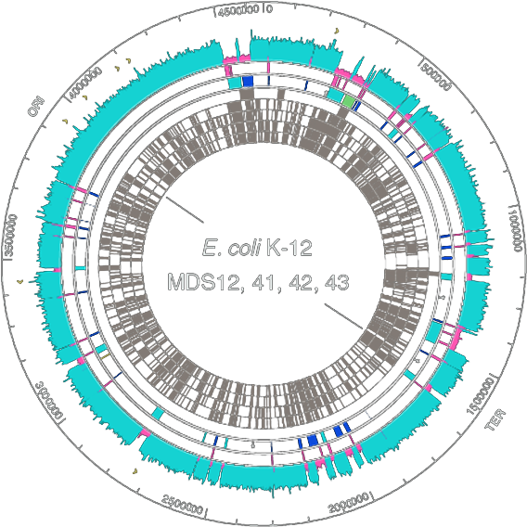
Construction of Minimal Genomes
Deletions in other enterobacteria
Deletions Made in E. coli K12 MG1655
Mycoplasma genitalium
Mesoplasma florum
Blattner and coworkers. Science. 2006 May 19;312(5776):1044-6
Notes:
There have been extensive efforts to define the ‘minimal chassis’ needed to sustain life, which, to a first approximation is these 3000 genes. One study by Blattner involved removing many chunks of the K12 genome to widdle it down to its minimum. In this figure, * the inner rings indicate deletions present in other enterobacteria, and the * outer-more ring indicates those that were successfully removed from MG1655 in combination. Other groups have focused on defining this minimal chassis in a more extreme sense. * The Mycoplasma are pathogenic bacteria that are so dependent on host cells that much of metabolism is absent in their genome. As such, their genomes are under a megabase, and the smallest is only 582kb. The smallest free-living bacterium is Pelagibacter ubique with only 1.3 Mb. Thus it is possible to have something smaller than 3Mb. However, most bacteria have 3Mb of these ‘housekeeping’ functions. The additional DNA that one finds in a bacterium encodes processes that aid that strain’s survival in some particular environmental niche. Sometimes these added genes are to survive in soil, others are for fighting with other organisms, others are for colonizing other organisms. It is amongst these genes that a great deal of diversity is found.

Slide 19
Understanding bacterial pathogenicity
What are virulence factors?
What is present in lab strains of E. coli?
What other dangers lurk in the genome?
Notes:
If you become a practicing genetic engineer, at some point you will be asked ‘is this stuff dangerous’? The short answer is, sometimes. There are unquestionably dangerous biological things that can be built. However, it is important to understand the axis of risk and how these emerge. Though pathogenicity represents only one category of concerns, it is the concern that most people have about genetic engineering and thus important to understand.

Slide 20
A Core Bacterial Chassis
Cell growth and division
The Central Dogma
Primary Metabolism
Environment Sensing
~3000 genes common to all bacteria
Encoded by ~3 million bases of DNA
Almost identical among Enterobacteria
Notes:
Every bacterium has some essential processes, and most encode 3Mb of this information. Some bacteria will be dependent on another organism to supply primary metabolism, and the amount of environmental sensing is variable, but there are some things a cell just needs to have to be a cell. When we deal with pathogenesis, there are always additional genes involved. These core processes alone are not sufficient for this behavior. The added genes that are associated with commensal or pathogenic behavior are collectively referred to as virulence factors.

Slide 21
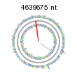
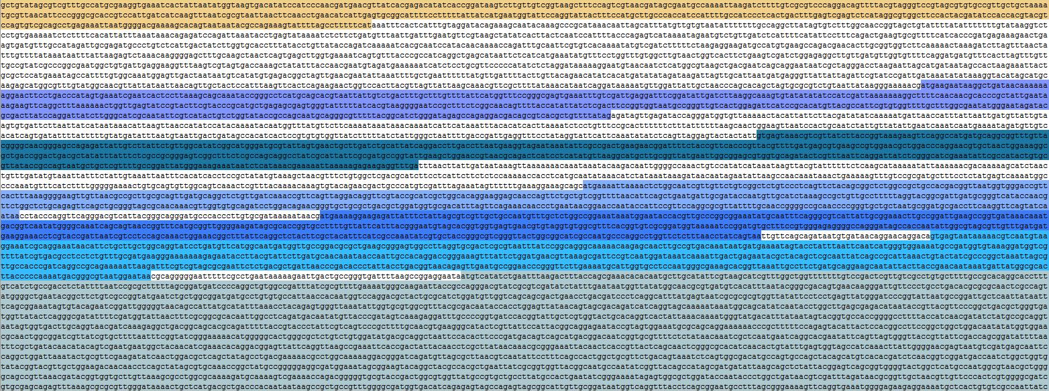
Type I pili
Notes:
In K12 strains of E. coli, there is one important virulence factor called type I pili. It is a proteinaceous surface appendage that mediates attachment to the walls of the intestine. It is thus necessary to retain a commensal bacterium within the gut, and also for pathogenic strains. The sequence of the gene cluster encoding type I pili is the fim cluster, and it is about 12 kb in length and all the genes are colocated at this specific site in the genome. Thus it is fairly easy to fully remove this virulence factor. However, it is present in most laboratory strains including DH10B and DH5alpha.

Slide 22
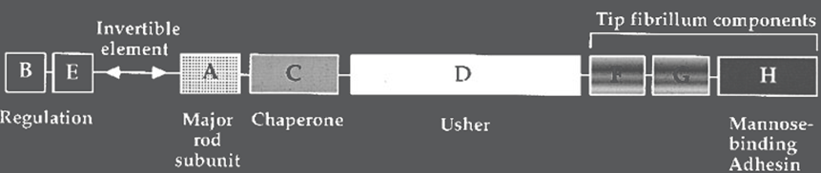
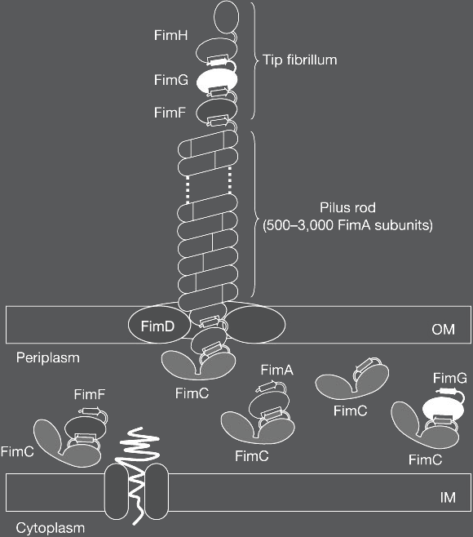
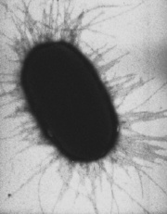
Type I Pili
Notes:
The appendage encoded by this cluster involves many genes. A few of them regulate the process and control the expression level of the various functional components. Ultimately, the pilus is a long polymer that extends from the surface with a mannose-binding adhesin on the tip. This tip binds to mannose residues on proteins lining the surface of gut epithelial cells.

Slide 23
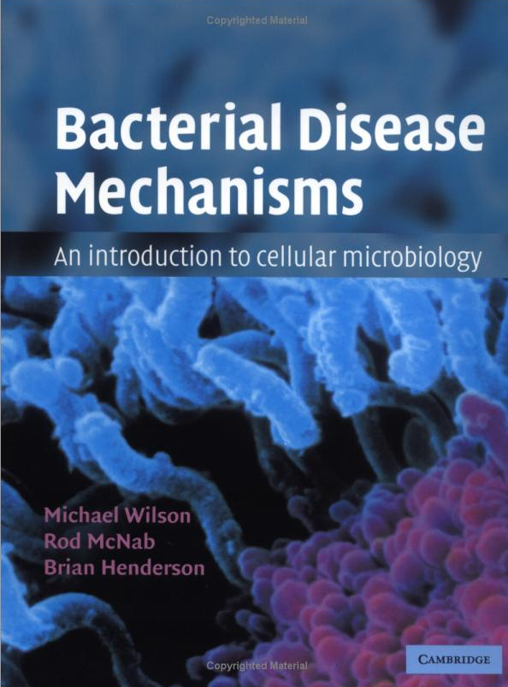
(some) Virulence Factors
Adhesion factors
High affinity iron transport
Capsular polysaccharides
Vacuole modifications
Toxins
Bacterial Disease Mechanisms: An Introduction to Cellular Microbiology
by Michael Wilson , Rod McNab, Brian Henderson
Basic immunology: http://www.niaid.nih.gov/Publications/immune/the_immune_system.pdf
Notes:
Virulence factors operate by diverse mechanisms to address distinguishable concerns. This book, bacterial disease mechanisms, is a great resource for learning more about the various mechanisms that exist. There are 6 categories of things: adhesion, iron transport, capsular polysaccharides, vacuole modifications, and toxins.

Slide 24
Virulence Factors
Adhesion factors
High affinity iron transport
Capsular polysaccharides
Vacuole modifications
Toxins
Type I Pili: Bind mannose surfaces
Type IV Pili: “twitching motility”
Sex Pili: Used in F-plasmid and RP4 mating
Bundle forming pili: highly virulence-associated
Non-pili adhesion proteins/invasins
http://en.citizendium.org/wiki/Pilus
Notes:
The type I pili we saw before are an adhesion factor. They enable the organism to adhere to surfaces within the host. There are many other adhesins. They are usually protein, but they have different functional roles. Type IV pili, for example, retract allowing the bacteria to pull itself around a surface in a process called twitching motility. We’ve seen sex pili in previous lectures during descriptions of conjugation. Here, initial adhesion to a recipient cell results in a channel through which a DNA is transferred. Some pili are highly associated with specific types of virulence. For example, the O157:H7 strains often encode bundle-forming pili, and these factors are important to the clinical outcome of infection. There are also many shorter adhesins including single-polypeptide surface appendages like invasin.

Slide 25
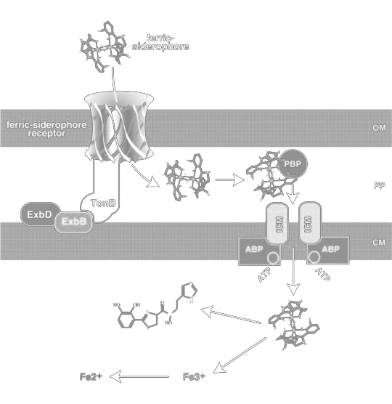
Virulence Factors
Adhesion factors
High affinity iron transport
Capsular polysaccharides
Vacuole modifications
Toxins
Notes:
High affinity iron transport is the mechanism by which bacteria obtain iron during an infection. All organisms sequester free iron both to protect themselves from free radical formation and to avoid pathogens. Iron is absolutely essential for any organism to grow, so pathogenic organisms have evolved exotic mechanisms for taking up iron from sequestered sources.

Slide 26
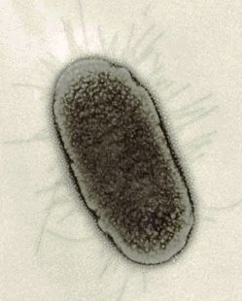
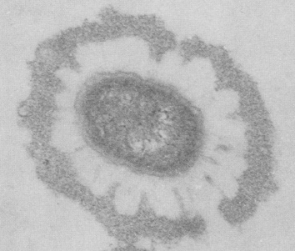
Virulence Factors
Adhesion factors
High affinity iron transport
Capsular polysaccharides
Vacuole modifications
Toxins
K-Capsule
O-Antigen
Periplasm
Jann et al., 1990.
MG1655 E. coli
O antigen, K capsule, NFA E. coli
Notes:
Capsular polysaccharides are present on almost all commensal and pathogenic isolates, but are not present in the modern E. coli lab strains. In the MG1655 micrograph, you see the type 1 pili extending from the surface, but otherwise the outer surface of the cell is the lipopolysaccharide, which is the major lipid component of the outer membrane. Natural isolates from animals and plants will have additional layers of material on their surface. In the enterobacteria, these are put into two different bins: the O-antigens and K-capsules. Both are carbohydrate polymers that extend from the cell surface, but there is tremendous diversity to the particular sugars present and the amount of it.

Slide 27
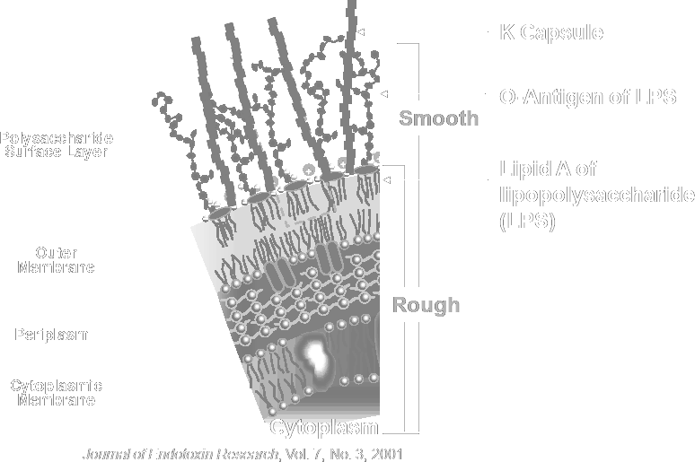
Virulence Factors
Adhesion factors
High affinity iron transport
Capsular polysaccharides
Vacuole modifications
Toxins
Protect against:
Complement opsonization
Phagocytosis
Notes:
The difference is that O-antigens are anchored to the LPS while K-capsules are not. There are various other surface modifications like the non-fimbrial adhesin that might be present on any particular natural isolate. By masking the bacterial surface, capsular polysaccharides protect the cell from antibodies, macrophages and neutrophils, but also phage infection. However, they also tend to interfere with transformation and thus the strains we use in the lab have lost this function. MG1655 in particular would be an O16 strain if it had just one more gene, which has been mutated in all the common lab strains. This O-antigen would protect the cell from phage infection but is not typically associated with pathogenesis.

Slide 28
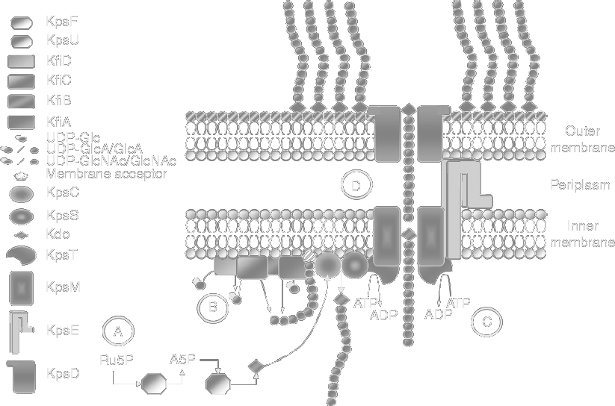
K5 Capsule Biosynthesis
David Corbett and Ian S Roberts, “Capsular polysaccharides in Escherichia coli,” Advances in Applied Microbiology 65 (2008): 1-26
Notes:
These capsular polysaccharides, like the type I pili, are encoded by large gene clusters at specific genome loci. If you compare two E. coli strains that make two different O antigens, you will typically find that the cluster is at the same position of the genome in both cases, but the specific sequence of the cluster is very different. K-capsules are often quite large. For example, K1 and K5 require 20kb worth of genes. These clusters become quite large because they typically encode all the nucleotide sugars and sugar transferases needed to build up a fairly complex polymer pattern.

Slide 29
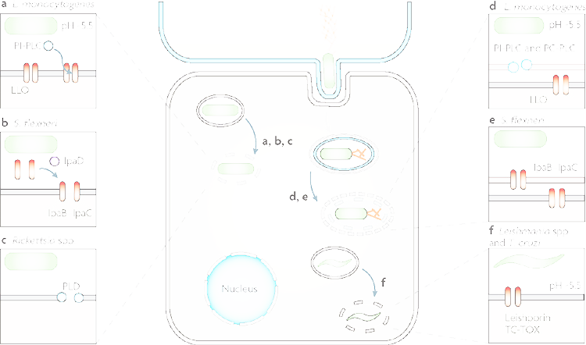
Virulence Factors
Adhesion factors
High affinity iron transport
Capsular polysaccharides
Vacuole modifications
Toxins
Hybiske, K. & Stephens, R.S. Exit strategies of intracellular pathogens. Nat Rev Micro 6, 99-110(2008).
Notes:
When macrophages or neutrophils engulf a bacterium, the bacterium enters a phagocytic vacuole which is basically just a bleb of the eukaryotic membrane surrounding the bacterium. Some bacteria also encode the ability to invade cells and become engulfed in one of these vacuoles. Without further intervention, these vacuoles will fuse with lysosomes and the bacterium will be destroyed. Some bacteria encode genes that either interfere with lysosome fusion, or pop the vacuole allowing the bacterium to freely move about the cytoplasm. The most commonly-cited examples are Listeria, Shigella, and Salmonella, but it is a fairly common virulence mechanism for bacterial pathogens.

Slide 30
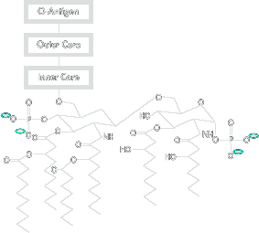
Virulence Factors
Adhesion factors
High affinity iron transport
Capsular polysaccharides
Vacuole modifications
Toxins
PAMPS:
(Pathogen-associated molecular patterns)
(cause sepsis)
Endotoxin,
Lipoprotein,
Non-CpG DNA,
fMet Proteins …
Toxins:
Shiga Toxin
Botulinum Toxin
Diphtheria Toxin
Hemolysins
Lipid A
Notes:
Finally we have toxins. There are some ‘toxins’ present on all bacteria. For example, all the enterobacteria have an outer membrane component called lipid A which is the lipid portion of the lipopolysaccharide molecule which is also called endotoxin. If you inject a significant amount of purified lipid A into a mammal, there is a strong response called sepsis that at high doses can lead to organ failure and death. More generally, endotoxin is one of several Pathogen-associated molecular patterns, or PAMPS. These chemical moieties are identified by the innate immune system and are a primary line of defense from infection. Though lipid A is the most potent of these, the outermembrane protein lipoprotein is also a strong agonist of the immune system. Since bacteria don’t do CpG methylation like eukaryotes, the unmodified DNA is also used by the innate immune system to detect bacteria. Also, the presence of formyl-methionine on n-terminal peptides is another PAMP.
*
Then there is another category of toxins which are more active in their effects. You’ve probably heard of some these: shiga toxin comes from Shigella, botulinum toxin is responsible for botulism and also for botox treatments. Hemolysin is a widely distributed functionality that causes red blood cells to lyse spilling heme into the bloodstream for consumption by microbes. The E. coli lab strains, like all bacteria, have many PAMPS. However, they do not encode any of these toxins and it is atypical to insert toxin genes into E. coli in biotechnology applications.

Slide 31
Protein Localization
What distinct compartments exist in a bacterium?
Where can a protein be directed in the cell?
Notes:
Though bacteria lack organelles, they nevertheless have several distinct compartments.

Slide 32
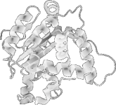
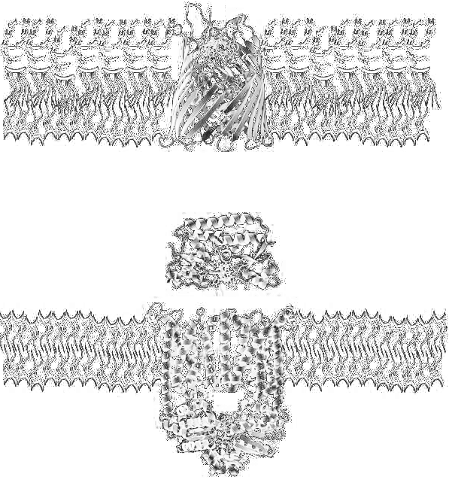
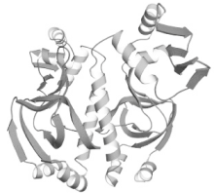
Protein Localization
Secreted
Outer Membrane
Periplasmic
Inner Membrane
Cytoplasmic
Notes:
The largest compartment is the cytoplasm where all the central dogma processes occur. Surrounding the cytoplasm is the inner membrane, and a protein can be peripherally associated with the inner membrane on either side. Alternatively, a protein can be fully integrated into the membrane. Beyond the innermembrane is a gelatinous environment called the periplasm. Proteins can be targeted here as well. Then there is the outer membrane which also contains proteins. Finally, there is the extracellular environment. Thus, there are 5 distinct regions to the bacterium, and proteins become localized to these regions through targeting.

Slide 33
In a Nutshell
Secreted
There are many secretion methods, all are iffy
Gram positives do this much more easily
Outer Membrane
Happens naturally for naturally OM things
Difficult (but doable) for things that don’t normally belong there
Periplasmic
Easy to do for sec secretion (prepro)
Alternate tat pathway for things that can’t fold there
Inner Membrane
Easy to do for things that belong there
Done through sec pathway (pre)
Cytoplasmic
Happens by default
Notes:
Since translation occurs in the cytoplasm, the default location for a new protein is the cytoplasm. It is very easy to target a protein to the inner membrane or periplasm by putting a short sequence called pre or prepro on the protein’s N-terminus. Some proteins targeted to the periplasm will spontaneously insert into the outer membrane, but it is often challenging to direct a protein here that is not from here in its native context. Finally, there are many ways to secrete a protein, but it is often challenging to do in E. coli. Since gram positive bacteria lack the outer membrane, the mechanisms of periplasmic targeted result in secretion in these organisms, and the process is much more efficient. Thus, in most biotechnology apps that involve protein secretion, either a Bacillus strain or a Pichia yeast is typically employed.

Slide 34
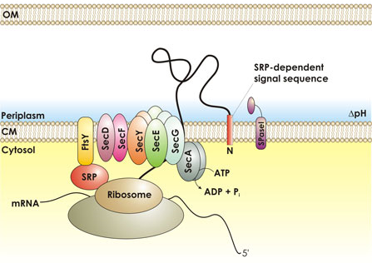
Sec Pathway Secretion
Signal (pre) sequence
“Signal Sequence”
“Leader Sequence”
18-30 aa in length
One or more basic aa near N-term
Central 7aa or more hydrophobic core
Notes:
To target a protein to the inner membrane or the periplasm, one puts a pre sequence on the N-terminus of it. These sequences are typically 18 to 30 amino acids in length and encode one or more basic residues near the N-terminus and a 7 amino acid hydrophobic core. The pre sequence is also called a ‘signal sequence’ or a ‘leader sequence’. It is recognized by a set of sec proteins that associate with the ribosome and actively transport the protein through the membrane.

Slide 35
Periplasmic Expression
Leader peptidases:
LspA processes prolipoproteins (major outer membrane components)
LepB “Signal Peptidase” or “SPaseI” cleaves most other proteins
Prepro sequences:
Use parts derived from well-expressed periplasmic proteins
pelB, ompA, ompT are commonly used
Some proteins are toxic in cytoplasm and not in periplasm
Some proteins require the oxidative environment for folding (such as antibodies)
A precursor to OM localization or secretion
Notes:
To get a protein from the inner membrane to the periplasm, all that is required is cleavage of the sec signal peptide. There are periplasmic proteins called leader peptidases that do this. LspA and LepB are two of these. The sequences they act upon are pre sequences more specifically called pre-pro due to the added processing. Rather than design these sequences de novo, it is most common to use ones from well-expressed periplasmic proteins such as pelB, ompA or ompT. There are various reasons why you might want to send a protein to the periplasm. Some proteins are toxic in the cytoplasm but just fine in the periplasm. Some, like anitbodies, requires the oxidative or calcium-rich environment of the periplasm for proper folding and production. Also, most proteins targeted to the outer memrbane or for secretion will first be transported to the periplasm.

Slide 36
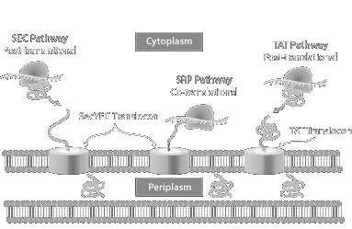
Twin-Arginine Translocation (Tat) Pathway
Signal Sequence: ((S/T)RRXFLK)
Notes:
There is another route by which a protein can get to the periplasm called the Tat pathway. Here, the signal sequence is a short peptide that can be anywhere in the sequence. The main difference between Tat and Sec is that proteins are transported after folding by Tat while Sec transports the protein in an unfolded state.

Slide 37
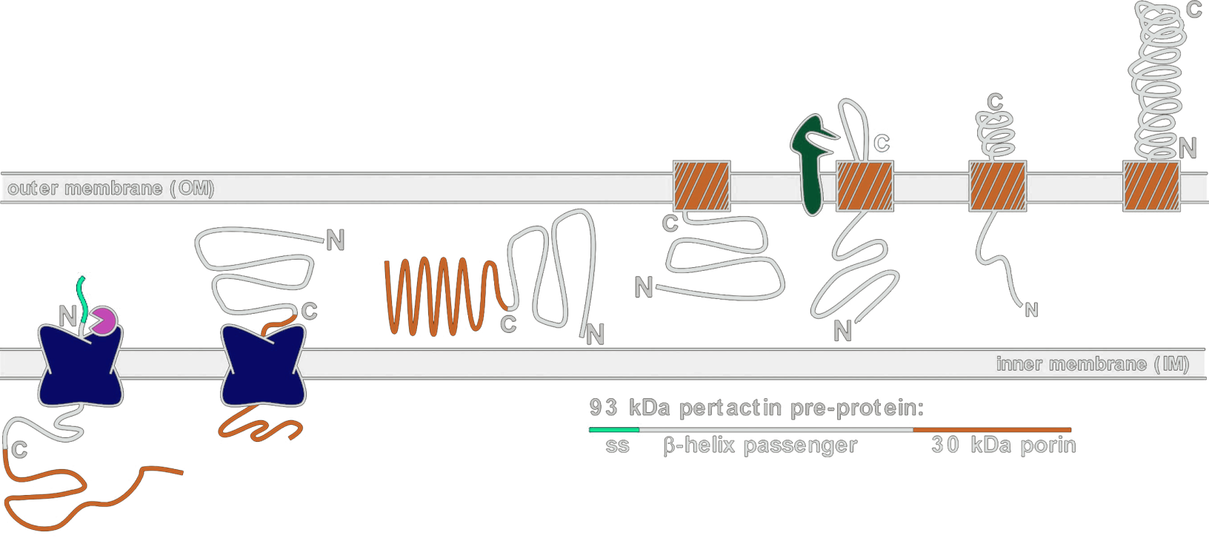
Outer Membrane Localization
Beta Barrel-type proteins
OmpA, OmpT, OmpG, LamB
Start with Sec secretion to periplasmic
Spontaneously insert into outer membrane
Autotransporters/Two-Partner Secretion
Ag43
Often cleaved “passenger” “Type V Secretion”
Dedicated secretion system for a single protein
Begins with Sec secretion
Notes:
Outer membrane proteins typically have a beta barrel structure that enables them to spontaneously insert into the outer membrane. The first step, however, is targeting to the periplasm by sec secretion. There are many mechanisms for getting proteins outside of the cell, but one simply mechanism is autotransporters and two-partner secretion. The most-studied example of this is the Ag43 protein. In autotransporters, one domain of the protein is a beta barrel that spontaneously inserts into the outer membrane, and then the ‘passenger membrane’ is pulled through the pore and displayed on the surface. Often the passenger domain will be proteolytically cleaved resulting in secretion. Two-partner systems do a similar thing, but the passenger and displayer domains are separated into two polypeptides.

Slide 38
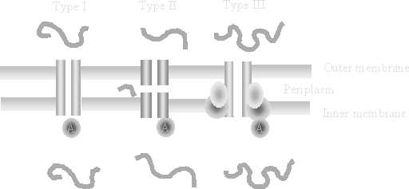
Extracellular Secretion
In gram positive bacteria (like B. subtilis)
No second membrane present
Prepro targetting results in extracellular secretion
Type I, II, and III Secretion
One set of genes assembles the pore apparatus
Transports a set of substrates through the channel
Notes:
Targeting a protein for secretion is very simple in a gram positive organism like B. subtilis since there is no second membrane. A gene encoding a protein targeted for periplasmic secretion in E. coli will encode a secreted protein in B. subtilis. However, there are other mechanisms by which a protein can be secreted in a gram-negative bacterium. We already saw autotransporters, but there are more elaborate routes. Types I, II, and III are the most common routes, and each requires additional proteins that form channels between the membranes allowing specific proteins to travel through.

Slide 39

Questions to Ponder

Slide 40
Betty tried to grow E. coli strain JM109 in minimal media. Why didn’t it grow? What does she need to do to make it grow?
Jimmy drank a flask of MG1655. Is he going to die?
Jill injected herself with MG1655. Is she going to die?

